Slide 1
Add new column with machine learning price prediction
Column of parcel distance to the nearest warehouse/distribution center and how the distance would affect the price
CS540 Mike Luo

Slide 2
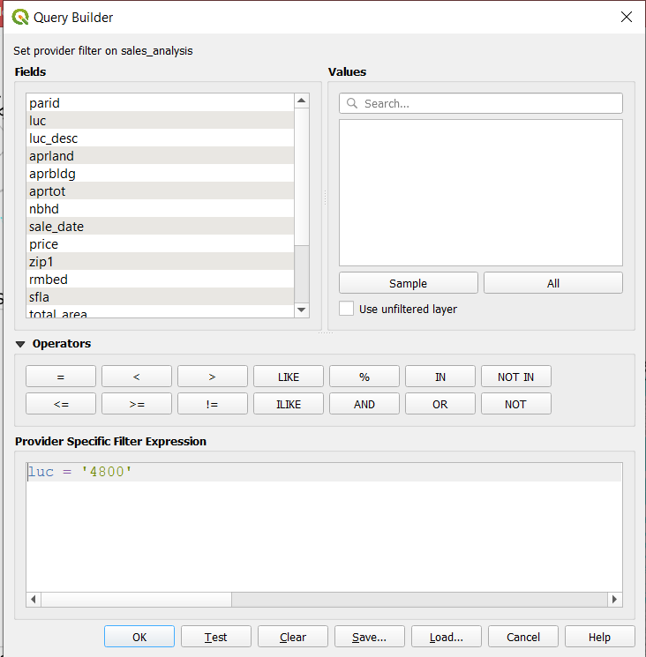
Make sure the parcel filter to only show warehouse

Slide 3
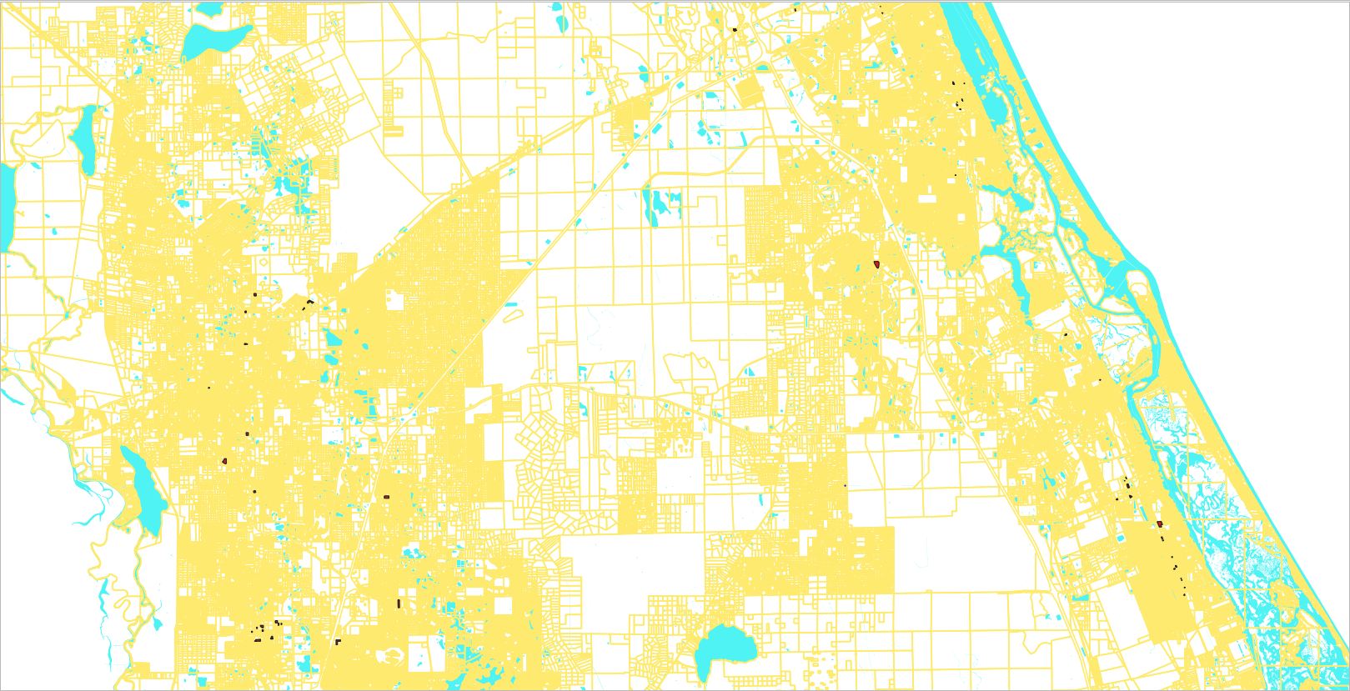
The dark spots are where warehouses/distributions located

Slide 4
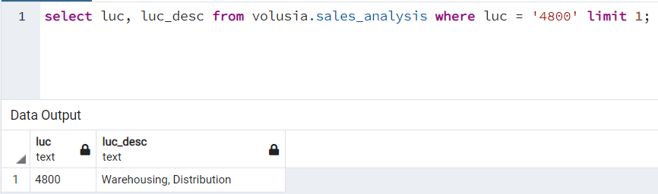
Now we know warehouse/distribution center code is 4800 -- all the sql codes can be found in my git as new_column_sql

Slide 5
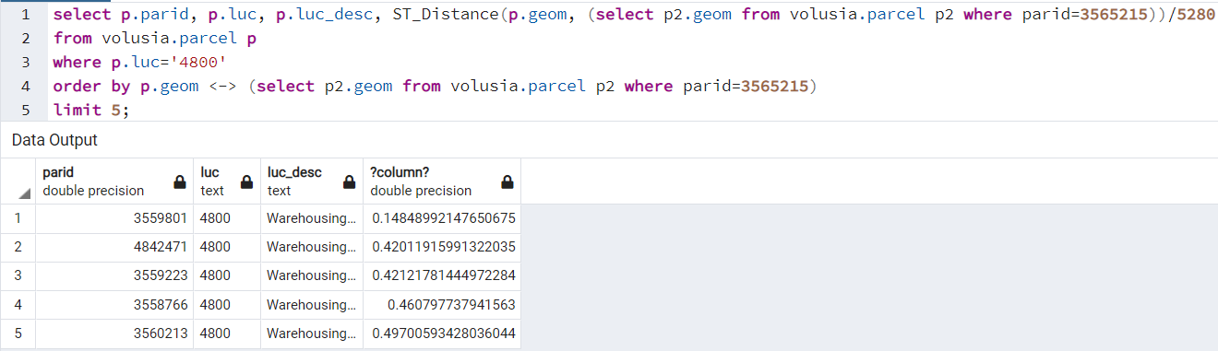
Find 5 nearest warehouse/distribution center given parcel# 3565215

Slide 6
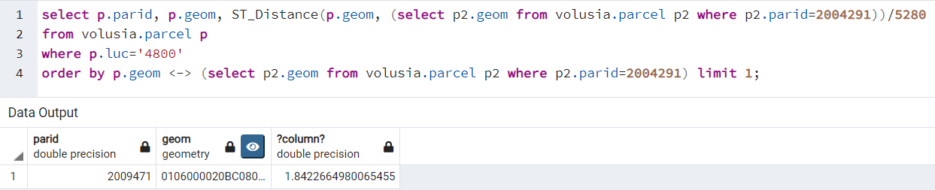
Find 1 nearest warehouse/distribution center given parcel# 2004291

Slide 7
Add a column to the parcel table, and update to find distance from each parcel to the nearest distribution center

Slide 8
Add geometry column

Slide 9
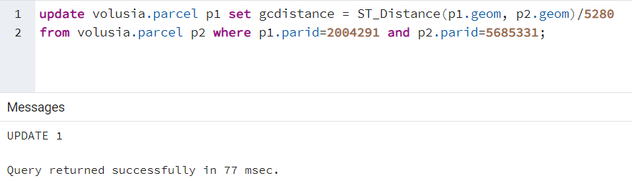
Distance Testing

Slide 10
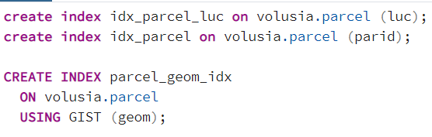
Create index for the records which will be used for loop through the distance between each parcel and the nearest warehouse

Slide 11
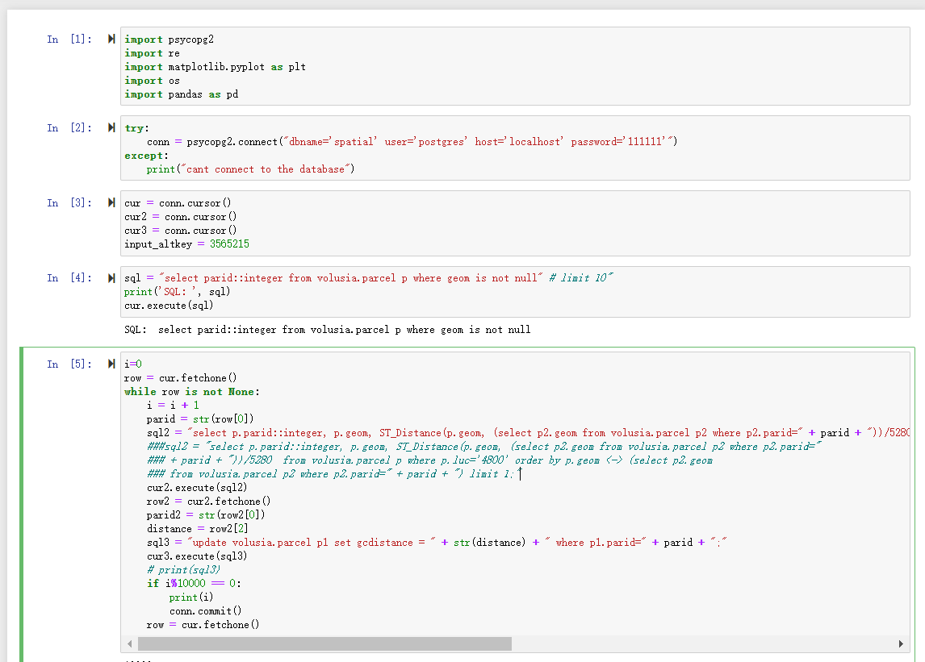
Loop through the records to calculate the distance between each parcel and the nearest warehouse/distribution center ## loop code can be found in my git as new_column_loop.ipynb

Slide 12
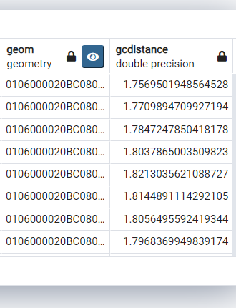
Gcdistance column created

Slide 13
Now move to Python, and use linear regression to predict if the house price is actually affected by the gcdistance from the nearest warehouse/distribution center ## regression code can be found in my git as regression.ipynb

Slide 14
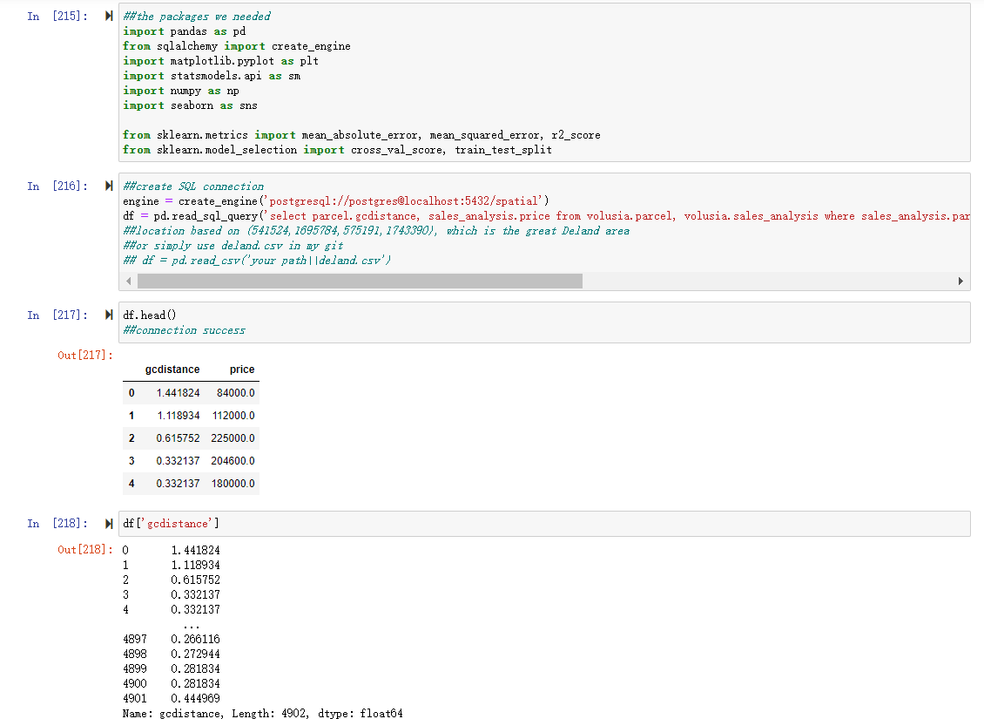
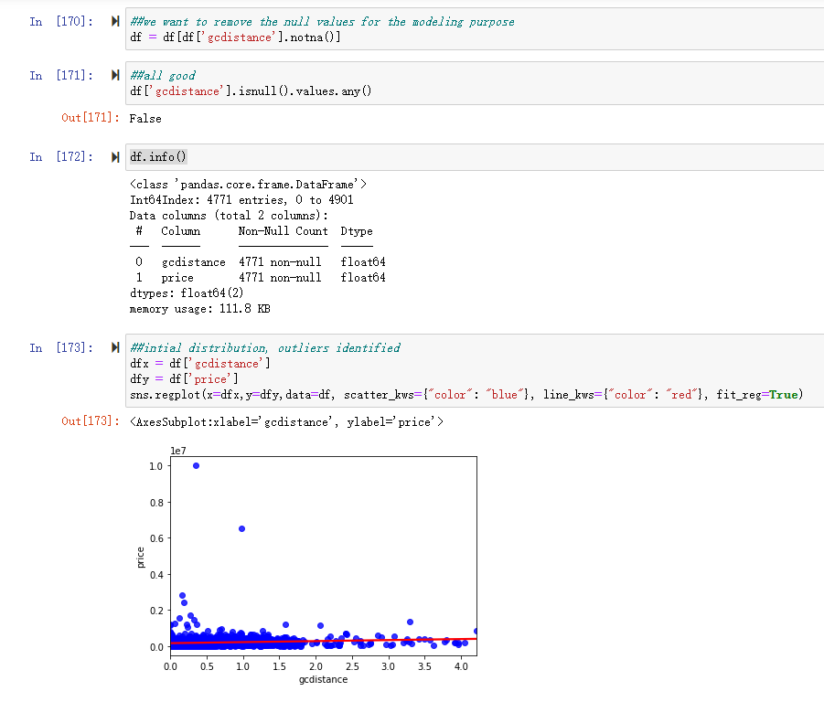

Slide 15
